Slide 1

Intelligent system to support children with autism
Artificial Intelligence
Prof. Dr. Abeer Mahmoud
T.A. Andrew Magdy
July 2023

Slide 2
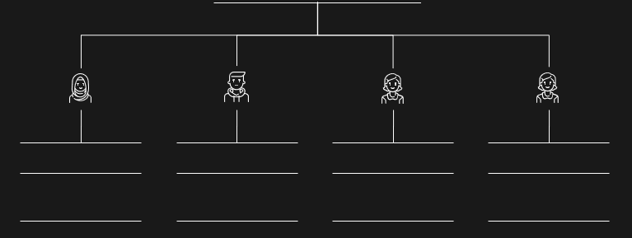
Our Team
Alzahraa Mofed
Antony Nabil
Aya Khaled
Amira Barakat
Nagwa Mohamed
Artificial Intelligence
Artificial Intelligence
Artificial Intelligence
Artificial Intelligence
Artificial Intelligence

Slide 3
Agenda
01.
02.
03.
04.
Problem & solution
Mythodology
What is ASD and how does our system adresses the issue
Explanation of the main Algorithms used in the system
Results
Conclusion & future
System testing and algorithms results
System conclusion and possible future improvement

Slide 4


The problem

Slide 5
Autism
Hyperactive, impulsive, and/or inattentive behavior.
Delayed movement and language skills.
Delayed cognitive or learning skills.
Hyperactive, impulsive, and/or inattentive

Slide 6

The problem

Slide 7
Autism spectrum disorder (ASD)
a developmental disability caused by differences in the brain.
problems with social communication and interaction.
restricted or repetitive behaviors or interests.
learning, moving, or paying attention can be challenging.

Slide 8

proposed solution
An educational system that aims to teach children with ASD in an entertaining way.
Helps negate the effect of ASD over time.
Improves motor and communication skills.

Slide 9
FEATURES
01
Face recognition

Slide 10
FEATURES
01
02
Face recognition
Facial expression recognition
Happy
Sad
Neutral
Angry
surprised

Slide 11
FEATURES
01
02
03
Face recognition
Face expression recognition
Happy
Sad
Neutral
Angry
surprised
Interactive Games
Car
Snake
Spinball
Card
Paint

Slide 12
FEATURES
01
02
03
04
Face recognition
Face expression recognition
Happy
Sad
Neutral
Angry
surprised
Interactive Games
Car
Snake
Spinball
Card
Paint
Educational videos
Fruits
Shapes
Colors
Prayers
Numbers from 0 to 10
And more

Slide 13

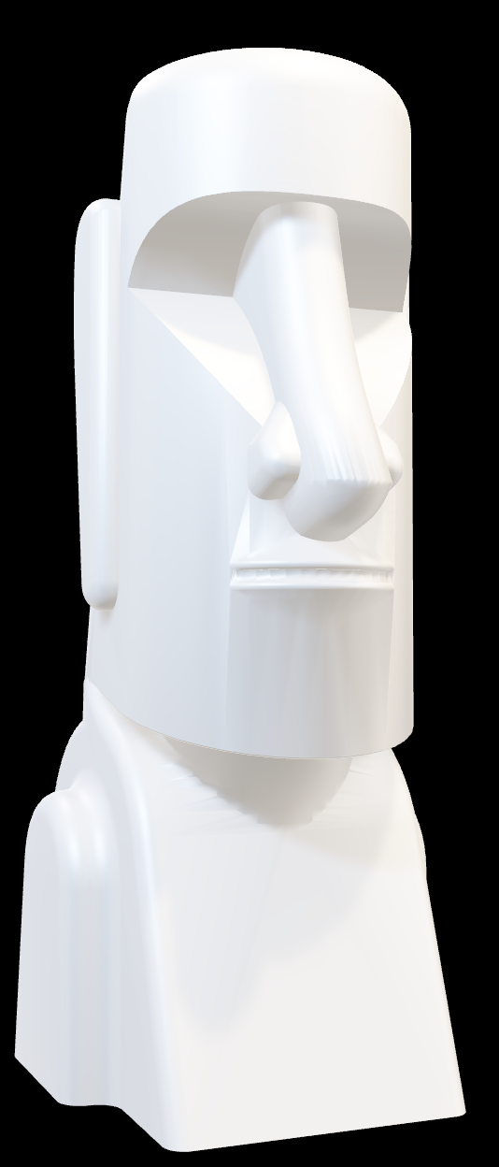
LBPH recognizer
Face recognition
The Local Binary Pattern Histogram is a technique used for facial recognition.
First, it creates an intermediate image by dividing the original image into small windows, calculating the LBP value for each, and combining them .
Next, histograms are extracted from the new image by dividing it into multiple grids, and concatenating the histograms to create a final histogram
Finally, the algorithm compares histograms between the input image and the training dataset using various distance measures and returns the ID as well as a confidence measurement.

Slide 14
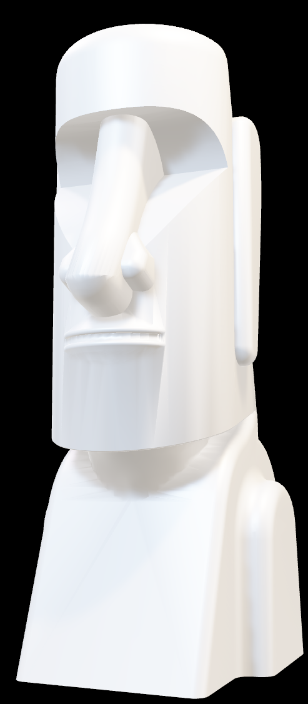
Haar Cascade
Face recognition
an object detection algorithm used to identify faces in images or videos.
It uses edge or line detection features and is trained on positive and negative images.
Haar features calculate the difference in pixel intensities in dark and light regions.
Integral Images reduce the computational complexity of calculating Haar features.
Feature selection is done using AdaBoost.
The Attentional Cascade technique simplifies the detection process by applying features in stages.
Viola-Jones method uses 38 stages with varying numbers of features to achieve a low false positive ratio and reduce the false negative ratio.

Slide 15
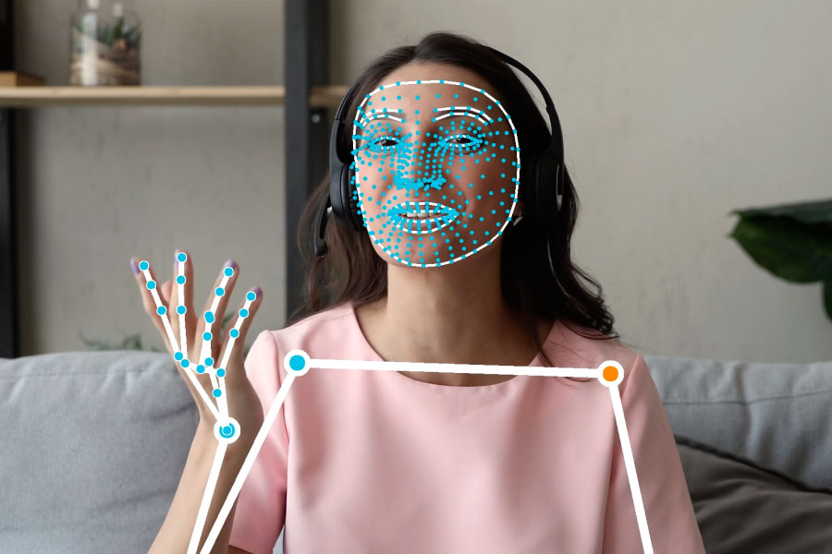

Slide 16
Hand Landmark detection model
Mediapipe
Detects the keypoint localization of 21 hand-knuckle coordinates
trained on approximately 30K real-world images, as well as several rendered synthetic hand models
Uses the bounding box defined by the hand landmarks model in one frame to localize the region of hands for subsequent frames

Slide 17
Face Landmark detection model
Mediapipe
Three machine learning (ML) models that can work with single images or a continuous stream of images.
The first model detects faces
second model locates landmarks on the detected faces
third model uses those landmarks to identify facial features and expressions.

Slide 18
Pose detection model
Mediapipe
Known as BlazePose
produces a full-body 33 point skeletal match
The Detector is an Single-Shot Detector based architecture. Given an input image it outputs a bounding box and a confidence score
The Estimator uses heatmap for training, but computes keypoints directly without.
Estimator otputs landmarks and (1,1) flags
The landmarks are (x,y,z,visibility,presence) for every 33 keypoints .

Slide 19
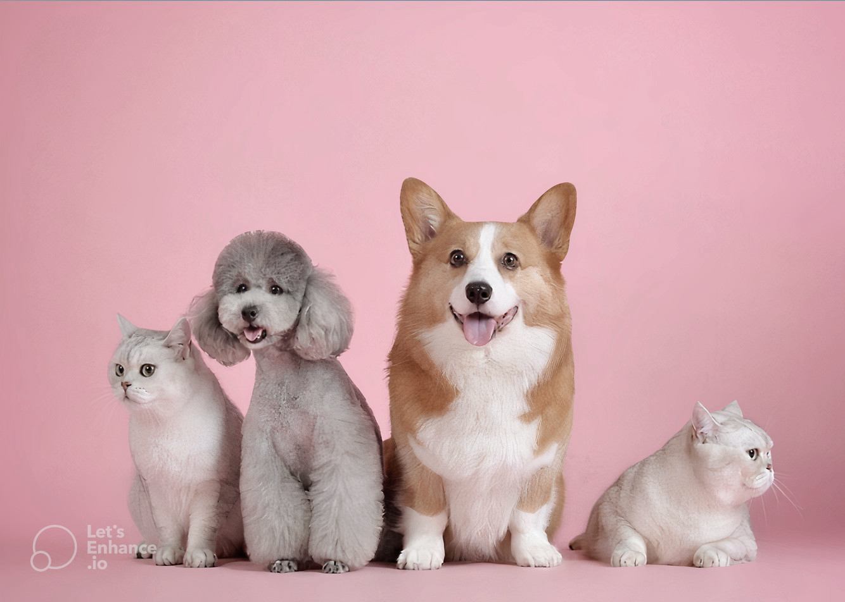
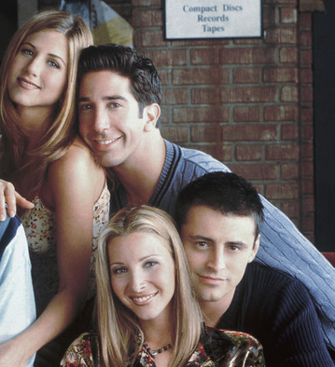
YOLOv3tiny
Object recognition and detection
CNN
Facial expression recognition

Slide 20


Slide 21
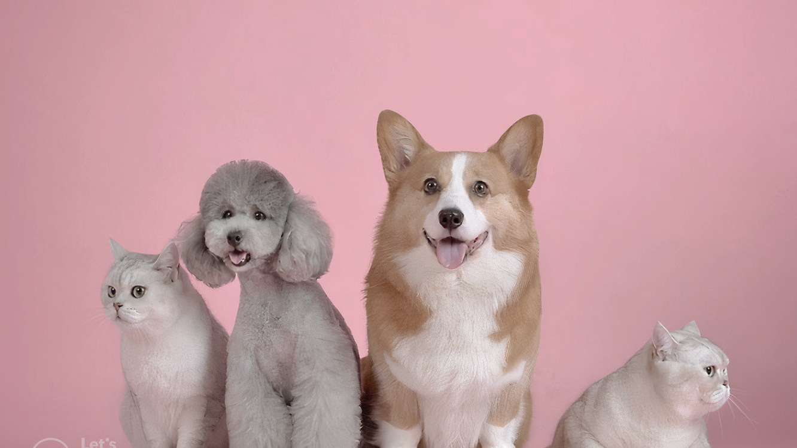
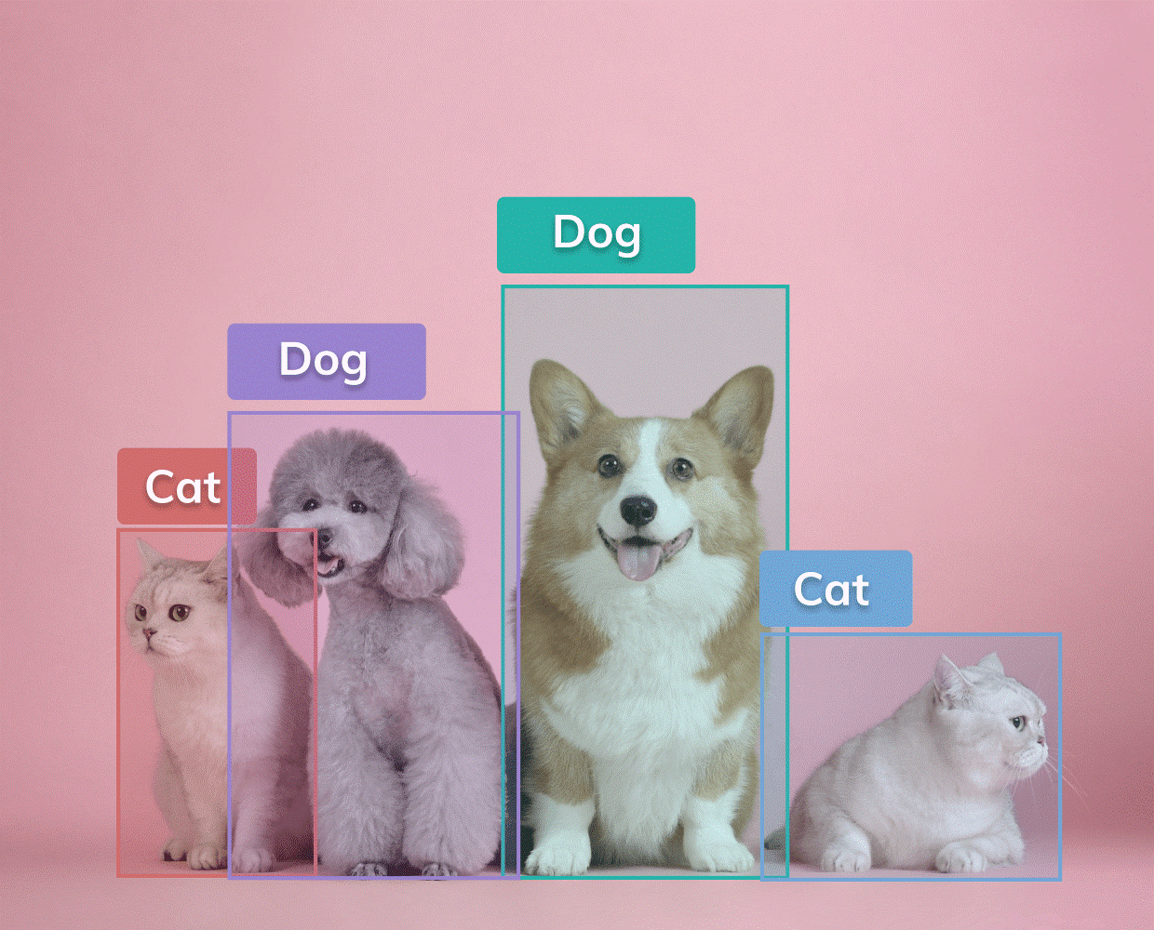
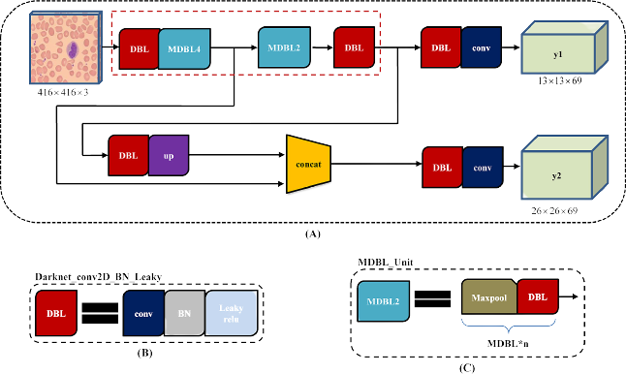
YOLOv3 tiny is a real-time object detection algorithm.
the YOLO algorithm uses features learned by a deep convolutional neural network to detect an object.
YOLOv3-tiny is a simplified version of YOLOv3
It’s faster and more efficient in terms of both training time and real-time object detection performance.
YOLOv3-tiny uses anchor boxes which are predefined bounding boxes of different sizes and aspect ratios that are used to predict object locations and sizes.
Architecture

Slide 23
YOLOv3
Object recognition and detection
CNN
Face recognition

Slide 24
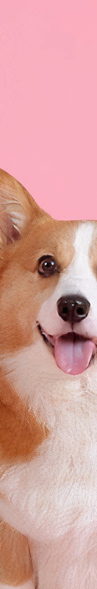
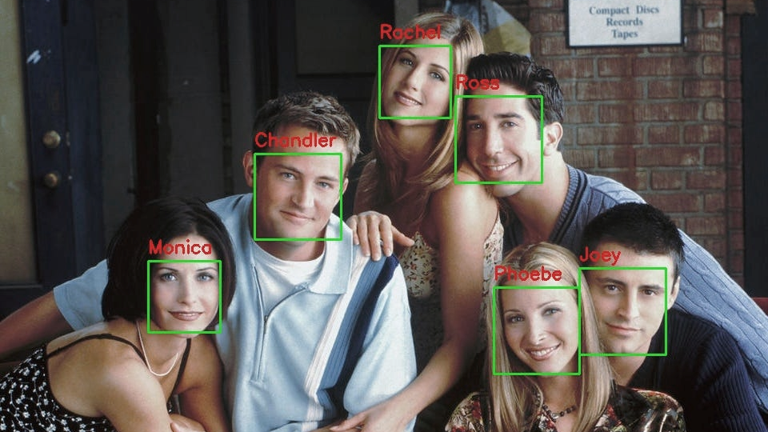
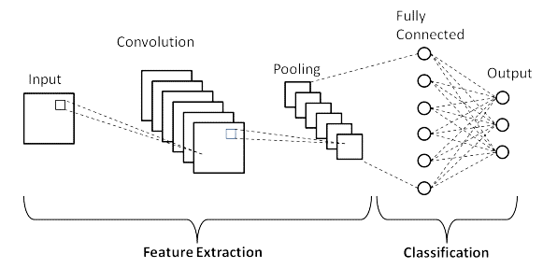
Our convolutional neural network is implemented using Keras with TensorFlow backend.
The model uses several convolutional & pooling layers with batch normalization and dropout, as well as two fully connected layers with dropout and a final softmax layer for classification.
The images are preproccessed and augmented using rescaling, rotation, shearing, zooming, width shifting, height shifting and horizontal flipping (validation images are preprocessed using rescaling only).
Four Blocks all are use elu activation functions, followed by batch normalization, max pooling with pool size 2x2, and dropout of 0.2.
The only difference is in the number of filters which are 32, 64, 128, 256 respectively.
Block five and six are a fully connected Dense layer with 64 units, elu activation function, batch normalization, and dropout of 0.5.
The only difference is that block five has an additional flatten layer at the beginning.
Output layer: A Dense layer with number of units equals to number of classes and softmax activation function for classification into number of classes categories.

Slide 25
YOLOv3
Object recognition and detection
CNN
Face recognition

Slide 26

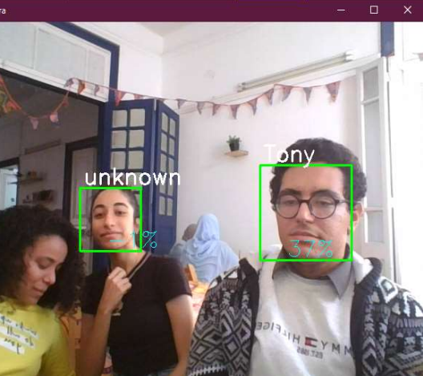
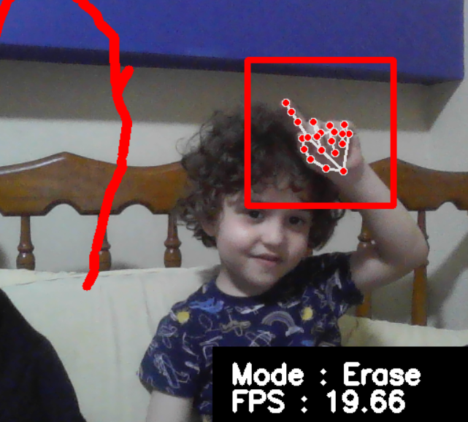
Results
Face recognition
Facial expression recognition
System Testing

Slide 27
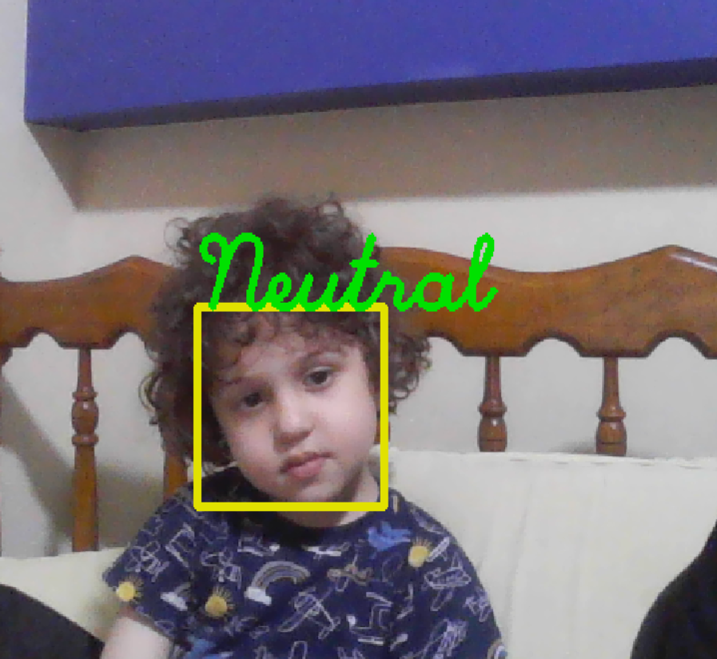
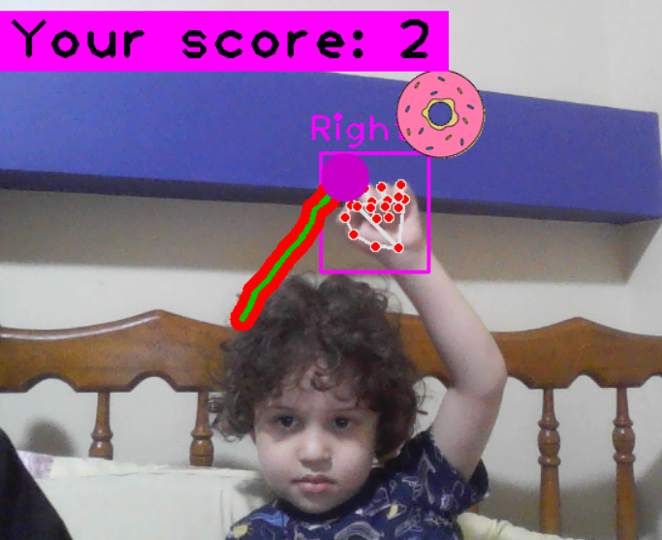
Face recognition
The system's accuracy is measured using a confidence score which is eculadian distance with a threshold value of 100.
the confidence score is sometimes lower than 50.
model works a lot better when the user's pictures in the dataset includes a variety of poses and movement.
Facial expression recognition
System Testing

Slide 28
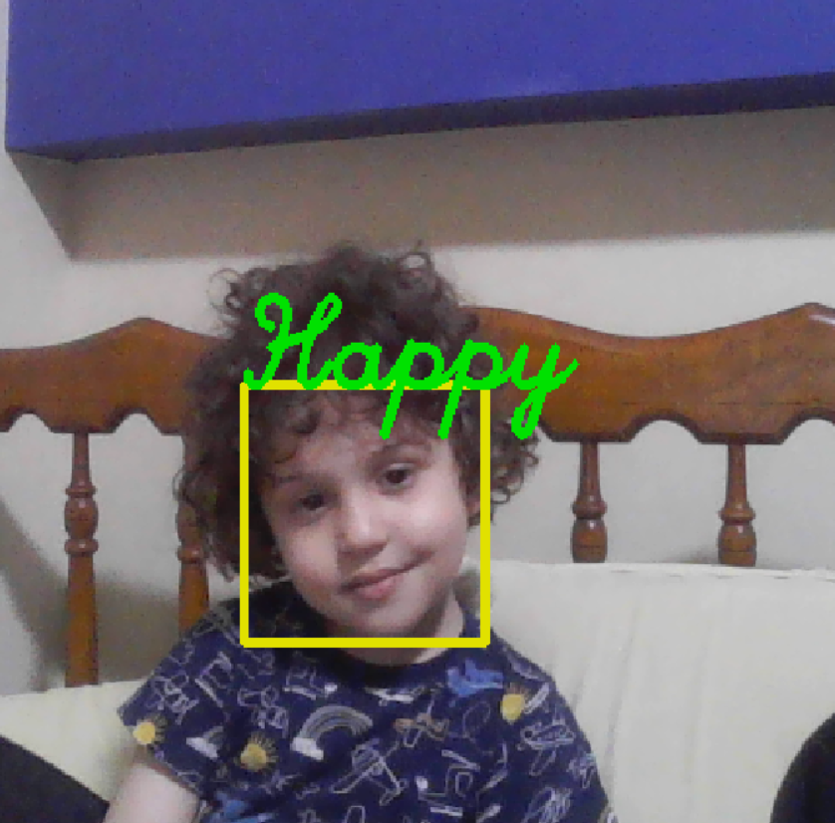
Face recognition
Facial expression recognition
Facial expression recognition is trained using a dataset obtained from a kaggle competition.
We chose to split the dataset into training and validation to obtain better overall accuracy. The validation accuracy: 68.19 %
System Testing

Slide 29
Face Recognition
Facial expression recognition
System Testing
Meet Ammar, a 5 years old child diagnosed with ADHD and level one of ASD.
Ammar was our first user, He enjoyed the colorful gui and was invested the entire time while using the system.
He really enjoyed the snake game and paint game especially the fact that he can change the drawing color while drawing.
He found it hard at first to play the spinball game and the car game, but after a while of practicing, he learned how to play.
We also tried the happy and neutral sequences:
He was responsive to both and the system was overall successful in educating and entertaining him.

Slide 30
Face Recognition
Facial expression recognition
System Testing
Meet Ammar, a 5 years old child diagnosed with ADHD and level one of ASD.
Ammar was our first user, He enjoyed the colorful gui and was invested the entire time while using the system.
He really enjoyed the snake game and paint game especially the fact that he can change the drawing color while drawing.
He found it hard at first to play the spinball game and the car game, but after a while of practicing, he learned how to play.
We also tried the happy and neutral sequences:
He was responsive to both and the system was overall successful in educating and entertaining him.

Slide 31
Face Recognition
Facial expression recognition
System Testing
Meet Ammar, a 5 years old child diagnosed with ADHD and level one of ASD.
Ammar was our first user, He enjoyed the colorful gui and was invested the entire time while using the system.
He really enjoyed the snake game and paint game especially the fact that he can change the drawing color while drawing.
He found it hard at first to play the spinball game and the car game, but after a while of practicing, he learned how to play.
We also tried the happy and neutral sequences:
He was responsive to both and the system was overall successful in educating and entertaining him.

Slide 32

Conclusion
&
Future work

Slide 33
Conclusion
The system was overall successful in obtaining the desired results.
The system in engaging and manages to entertain and educate at the same time.
the system is effective in helping children manage their symptoms and improve their motor functions and communication skills.

Slide 34
Future work
The system can be integrated into a robot or an online server and distributed on a wider scale to reach more children with ASD.
The educational videos can be transformed into interactive programs to fully leverage their benefits.

Slide 35

Thank you
Any questions?

